Slide 1


Slide 2
Scalable RAG with Azure Cosmos DB for NoSQL
James Codella, PhD
Principal Product Manager
Azure Cosmos DB

Slide 3
Agenda
What is Azure Cosmos DB
Who is using it?
GenAI use cases
Vector Search and more
Demo

Slide 4
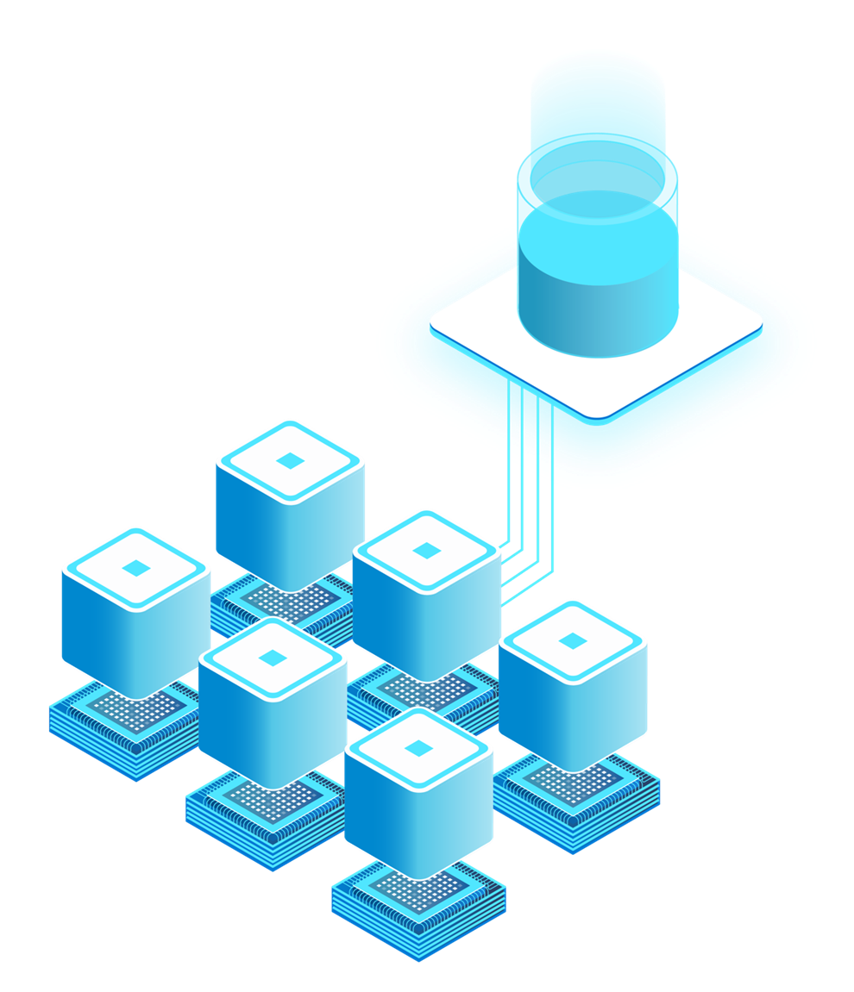

Azure Cosmos DB
is the world’s most scalable AI database
Serverless or Provisioned Throughput
Automatic sharding/partitioning
High elasticity with instant autoscale
Low latency, real-time data transactions
Mission critical reliability (99.999%)
5 levels of multitenancy
Built-in vector index and search with DiskANN

Slide 5





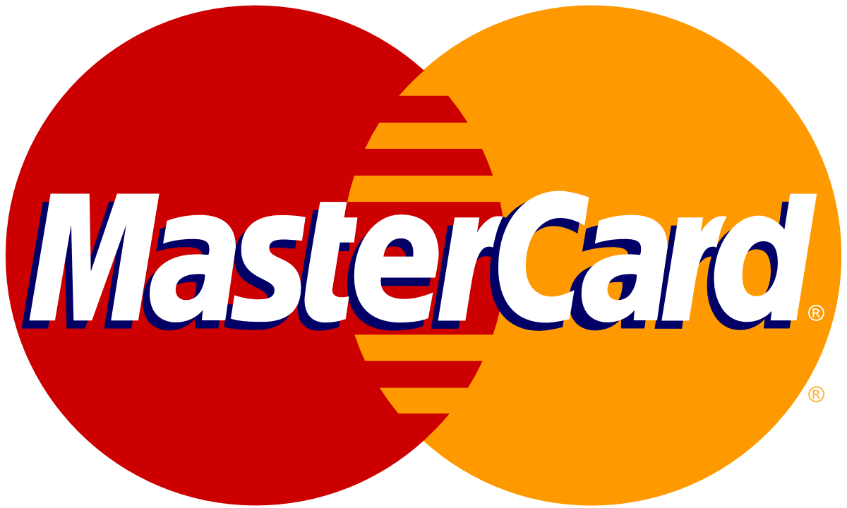
AI scenarios with Azure Cosmos DB for NoSQL
Chat history
Retrieval Augmented Generation (RAG)
Multi-tenant
AI apps
Real-time Recommendations
Real-time
Anomaly Detection
Multi-Agent AI

Slide 6
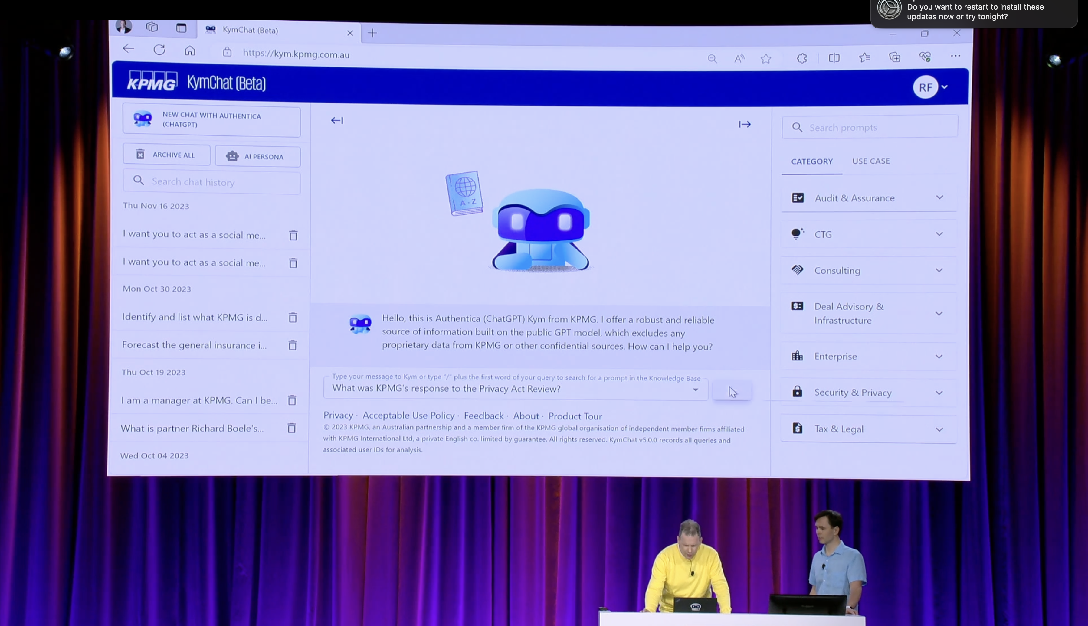

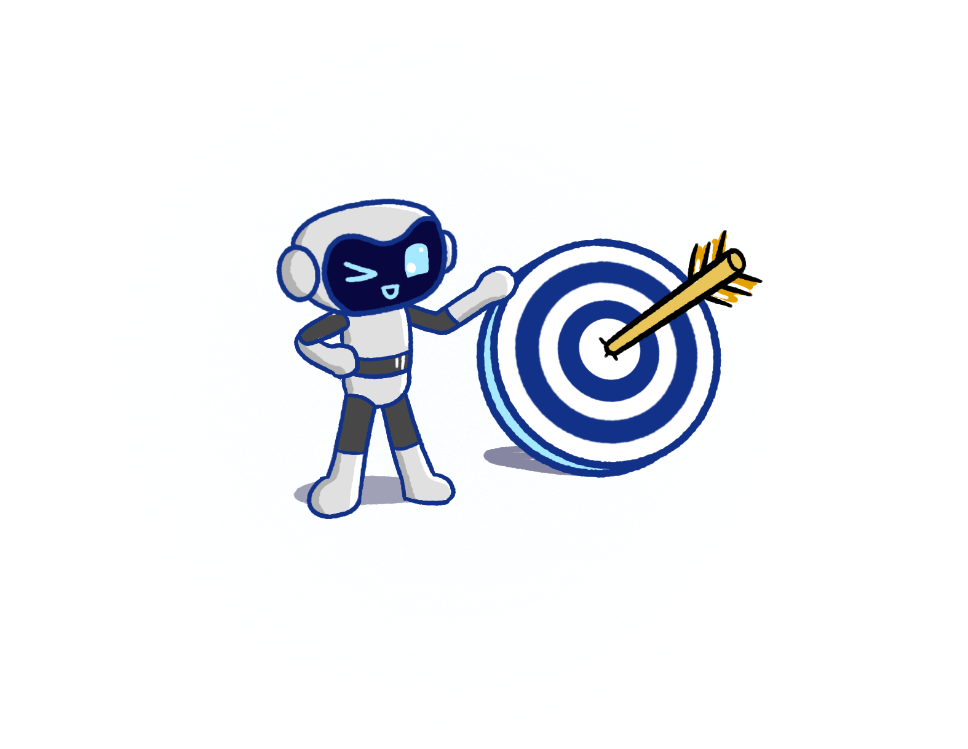


KymChat
KymChat is an AI agent to streamline KPMG employee operational tasks such as research, drafting proposals, documents, and communications.
Leveraging Vector Search in Azure Cosmos DB for MongoDB vCore enabled KPMG to provide value to their employees at scale.
KymChat demo at Ignite 2023
Accuracy
PCI, a key relevancy metric increased from 50% to 90%+
Performance
7,000+ employees
Up to 50% productivity gain
Scalability
Performance improvements enabled rollout to all KPMG member firms
Notes:
PCI = prompt confidence index

Slide 7

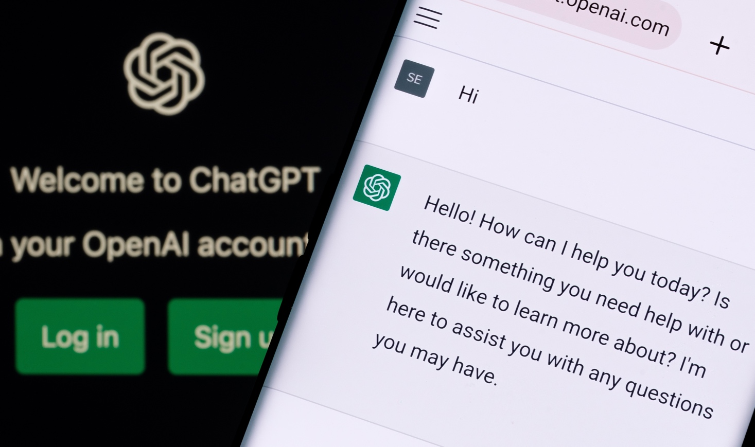


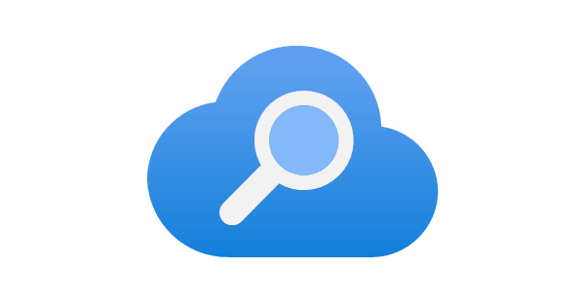
ChatGPT scales with Azure Cosmos DB
OpenAI
Challenge
Meet incredible demand from traffic spikes, without having to worry about database operations
Outcomes
Rapidly and seamlessly scaled as service grew, with zero downtime
Able to iterate fast on data shapes thanks to schemaless flexibility
Maintained high performance and availability
Key Azure products used:
Open AI stores ChatGPT conversations and all other user interactions in Azure Cosmos DB, 40+ workloads
Azure Cosmos DB
Azure Kubernetes Service
Azure AI Search

Slide 8
Azure Cosmos DB + AI
Today

Slide 9
GenAI use cases with Azure Cosmos DB
What
Why
When
a
Drastically reduces latency
Saves on Token consumption
Reduces costs and latency for LLM
Semantic Caching
Slow moving / static content
FAQs, Policies…
Conversational context
UX improvements
LLM optimizations
Auditing
Chat History
A MUST for Chat sessions
Improving cost & performance
Retrieval Augmented Generation (RAG)
Personalize LLM on your data
Cheaper than fine tuning
Faster iteration on new data
Any workload for GenAI apps
Vector + Operational Database
No ETL
Consistent data
Reduce complexity & costs
Data & vectors together
Cosmos DB scale & performance
Notes:
With these capabilities, the possibilities for Gen-AI scenarios using Azure Cosmos DB expand greatly.
Combining an Operational + Vector database, eliminates the need to ETL data into a single purpose vector database, reducing complexity and cost.
Building RAG Pattern applications gets easier and enables Gen-AI applications in mission critical and real-time workloads.
Cosmos DB has always been a favorite for building Chat applications. Users can now take chat history to improve user experience and optimize their LLMs.
And finally, it enables new innovations such as semantic caching, which drastically reduces costs and improves performance even more.
However, we’re not done yet. Azure Cosmos DB is known for its performance and scale, and we’re are going to take things even further.

Slide 10
Announcement slide (dark) with color wipe
Azure Cosmos DB for NoSQL
May 2024
Native Vector Indexing and Search
(Public Preview)
DiskANN Index
(Gated Preview)
Integrations
Semantic Kernel
LangChain
Microsoft Confidential: Content is shared under NDA with Microsoft CAB members

Slide 11
Vector Search in Azure Cosmos DB for NoSQL
Store data + vectors together
Reduced Complexity & Cost
Transactional Data & Vectors
Optimized for App Developers
Vector Search
+ Query Filters
Combine with equality, range & spatial filters
Optimize query focus
Flexible
Indexing
Flat, quantized flat, and DiskANN indexing available
Azure Cosmos DB for NoSQL Capabilities
Serverless or provisioned throughput
Built-in multitenancy
Instant & dynamic autoscale
<10ms point-reads
Globally-replicated
Industry-leading 99.999% SLA
Notes:
Store data and vectors together
Keep your data and vectors consistent and in-sync
Simplified architecture using a unified database for both vectors and data.
Vector Search + Query Filters
Find the most relevant documents
Leverage rich NoSQL query syntax
Flat index
100% accuracy
Ideal for multi-tenant scenarios
Quantize vectors for improved performance

Slide 12
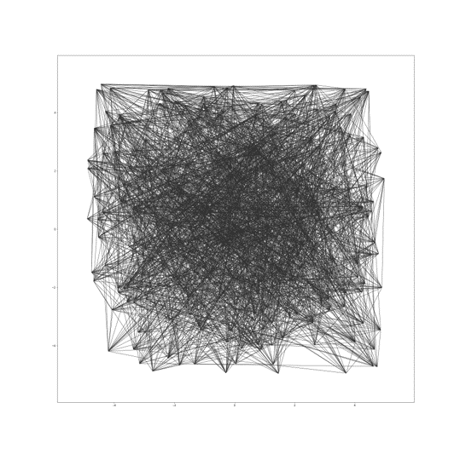

Multi-modal database with built-in DiskANN*
Scalable and cost effective, ideal for multi-tenant apps
Vector compression
Storage and graph construction
Algorithms
Large Vectors
{ D1, D2, D3, D4, D5, …, D99, D100 }
RAM
Compressed vectors
Quantization
SSD
Compressed Vectors
{ D1, D2 .., D10 }
Full vectors + graph
Unlimited scale
Low latency
Robust to data changes
Serverless
^{*In preview, GA November ‘24}
Notes:
OWNER: KIRILL
Contrast with Mongo, AWS, GCP (Scann) Talking points:
Powers Bing and M365 copilots
Unlimited scale: indexes with up to 400B vectors, trillions data points
Low latency, single-digit ms
Robust to data changes, highest recall per TPS, e.g. >90% recall at million TPS
Serverless and multi-tenant friendly, demands >60x less memory than HNSW
Vector and Hybrid search (w/Full Text search and re-ranking) on operational data on top of same inverted index
LangChain and Ecosystem Integration

Slide 13
DEMO
Using Python + Azure Cosmos DB for NoSQL + Azure Open AI to build a chatbot featuring
RAG
Chat History
Semantic Caching

Slide 14
Links
This demo: aka.ms/CosmosDBRAGwithPython
Docs, demos, videos, and more: aka.ms/CosmosAISamples
Azure Cosmos DB Vector Search: aka.ms/CosmosVectorSearch

Slide 15
Azure AI Advantage free offer
Up to $6,000 Azure Cosmos DB free for 90 days¹
Eligibility: customers using Azure AI Services or GitHub Copilot
Why Azure Cosmos DB for Era of AI
AI ready
Guaranteed performance and scale
Flexibility and efficiency
Mission critical
Learn more: Aka.ms/AzureAIAdvantageBlog
*Terms & conditions: Offer available to all Azure customers who are using or will use Azure AI Services (including Azure OpenAI Service), Azure Machine Learning, Azure AI Search) and/or GitHub Copilot. Offer provides 40,000 RU/s for free for a 90 day period. Offer only available where Azure Cosmos DB available. Customers must create a new Azure Cosmos DB account and register via Microsoft Form at https://aka.ms/AzureAIAdvantageSignupForm. Time period: the last day for customers to opt-in for the offer via the signup form is June 30, 2024.

